Slide 1
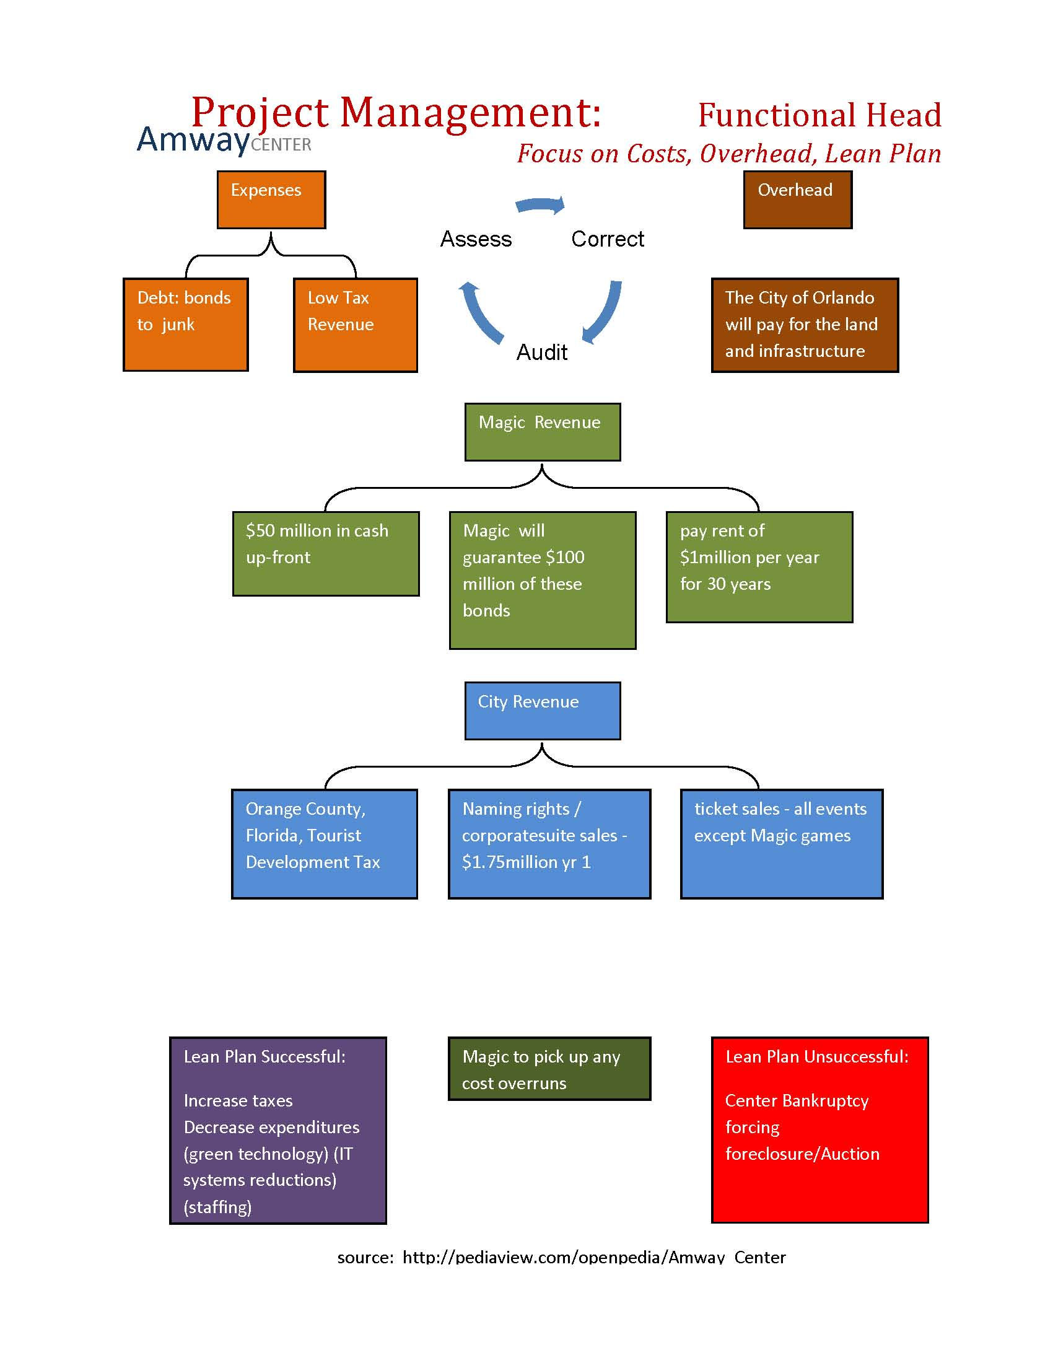
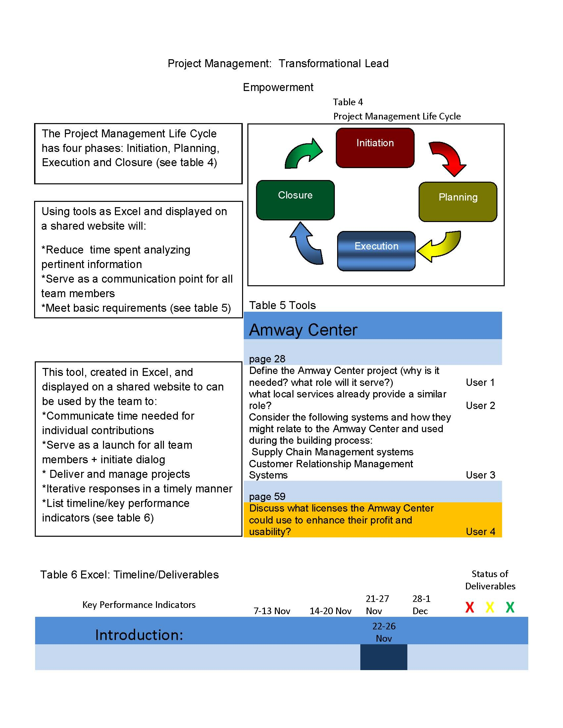

Slide 2
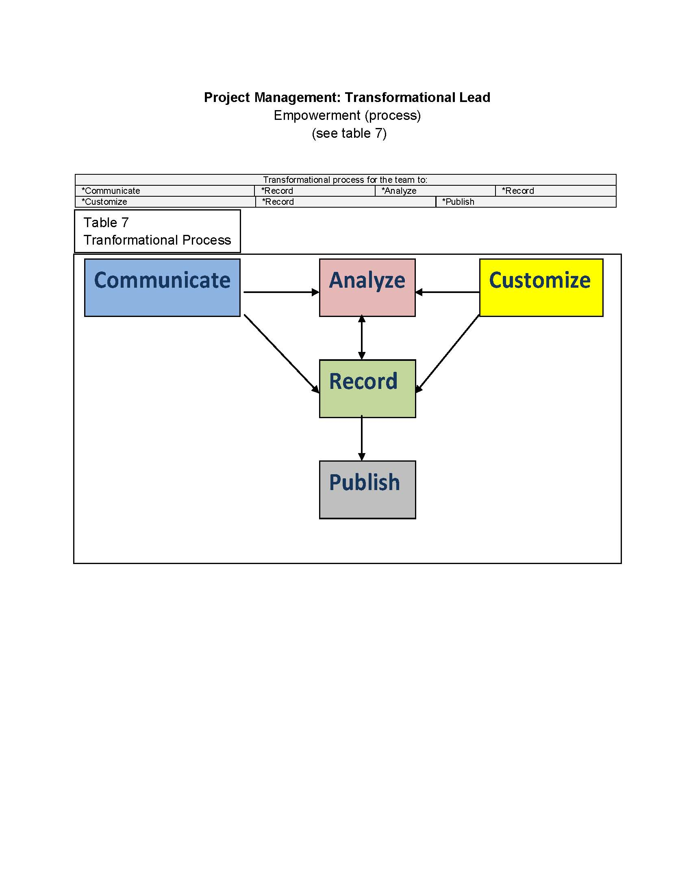
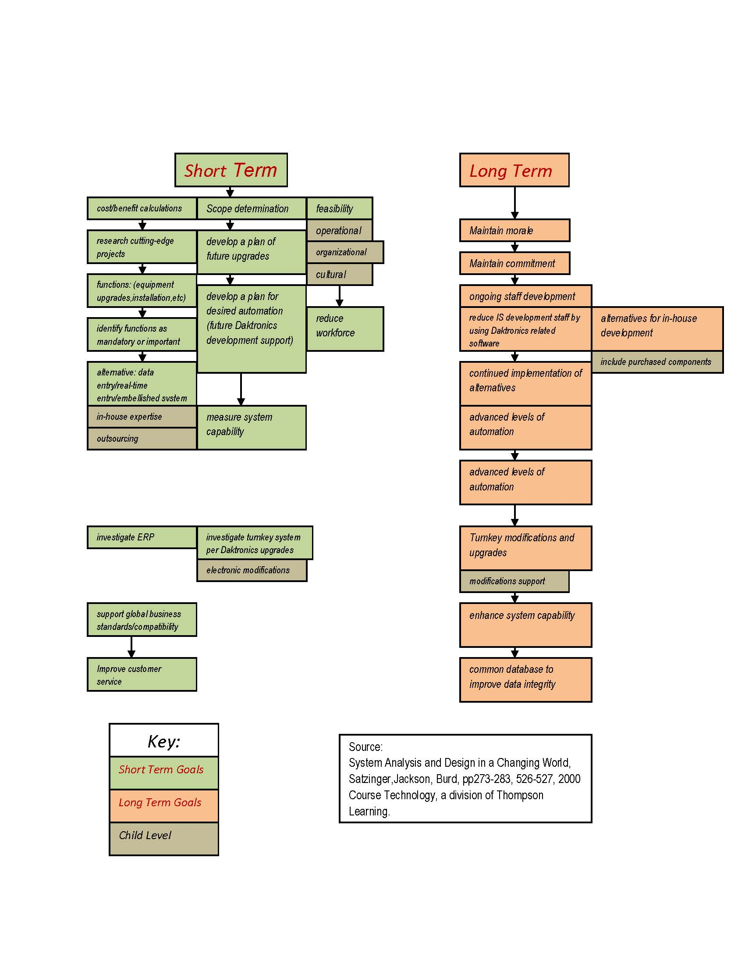
Project Management: Business Strategist Amway Center Short & Long Term Bottom Line Goals
Daktronics, Inc. will WOW the world with its integrated super system both inside and outside the Amway Center to bring the audience a full digital experience. Will it be prudent to put ALL of the eggs in the Daktronics’ basket, or should the Amway Center have its own key support? Short and long range bottom line goals point to the success of this super system as it grows and improves into the future (see Table 7a). As the Amway Center begins to answer the community’s questions for appropriate venues, the super system will modify and improve to meet those needs. Staying on top of the entire system, the Amway Center can hold close the control and supervision that is needed to best benefit the Orlando and surrounding communities. Turnkey systems have their benefits, but as this center becomes integrated into the central Florida community, procedures will need to be in place for optimum success for a robust system that will continue to support the specific IT requirements to maintain and upgrade what is taking place on the “ground level”. As the venues’ systems become more complicated and demanding, the Amway Center’s IT department will step up to the plate to support and implement a successful system to pull off the shows for excited audiences.

Slide 3
Amway Center SWOT Analysis
Benefits Outweigh Burdens
Strengths Design | Focus
Weaknesses Location | Debt
Opportunities Capacity | Services
Threats Fluctuations | competition

Slide 4
SMARTER Measured
Steps
Measurable
Achievable
Skills
Time
Ethical
Recorded
approval
Asset to environment
approval
Project mission
approval
Systems: Experienced reputation
installations
Ground breaking
Employment boost
Construction initiation
communications
1 yr: Ground breaking
Proven deliverables
neworking
construction
New shopping
naming
definitions
1 yr: naming
guarantee
compatibility
Systems installation
Grand opening
leadership
1 yr: opening
Best practices
Interior|exterior displays
opening
Railroad connection
Best practices
leadership
Community improvements
training
Old arena demolition
retraining

