Slide 1



The Amway Center is a premier sports , events and entertainment venue in Orlando, Florida and the home of the Orlando Magic of the NBA and the Orlando Predators of the AFL.
2 NBA large locker rooms; 6 star performer dressing rooms; green rooms for staging and hospitality; additional auxiliary locker rooms, including an official’s locker room.
Full basketball practice court that can also be used for events seating up to 500 people.
Media interview room and working media facilities on Event Level.
Large LED video board on I-4 exterior façade for event advertising.
31,000 sf arena floor for exhibition/trade show space, banquets and meetings.
5 banquet rooms and a conference room on the Club Level.
6 loading docks.
The Amway Center is dedicated to bringing the best entertainment (sporting, events, and concerts) to the Orlando Area. They now provide the “Ultimate Venue for Every Performer” and boast :

Slide 2
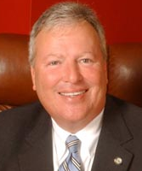
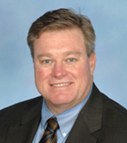
The Amway Center was designed to reflect the character of the community, meet the goals of the users and build on the legacy of sports and entertainment in Orlando. So what are people saying?
"I'm very excited,” Irvin said. “I've been checking out the progress all year and can't wait to get inside.“
Ed Irvin
Orlando Mayor Buddy Dwyer, “This community venue was built by and is dedicated to the residents of Central Florida. Previously, our region lacked the modern facilities needed to attract top notch entertainment and sporting events, forcing residents to travel elsewhere to experience them. Orlando is now home to one of the most technologically-advanced areas in the country providing a vast array of cultural, sporting and entertainment options to residents.”
"This lobby is just huge to walk in,” said Todd Ludington from Orlando. “It's just open and lots of light and lots of windows. It’s incredible."
Allen Johnson, the Executive Director of Orlando Venues which manages the Amway Center, “Orlando Venues exists to provide the citizens of Central Florida with a diverse collection of sports, arts and culture designed to excite, inspire and create the ultimate entertainment experience.”
“It is gorgeous, and guess what? Plenty of bathrooms," said Joanna Wallace.

Slide 3
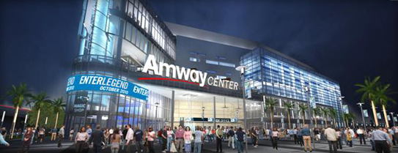
This is unlike ANYTHING Orlando has ever seen! Come see for yourself!

