Slide 1
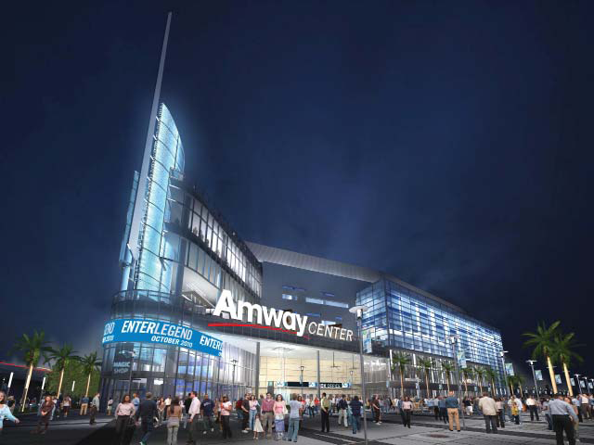
Amway Center Orlando Florida
By Determined Colette
Changing Sally
Determined Marie
Joy Yashica

Slide 2
Table of Contents
Title Page | 1
Introduction | 3
History | 4-5
SWOT Analysis | 6
SWOT Defined | 6-7
Advertisements | 8-10
Future of Amway Center | 11
Project Management: Functional | Empowerment | 12
Project Management: Goals | Empowerment Process | 13
SMARTER Measured | 14
GUANXI | Kaizen | Risk Adversity | 15
Conclusion | 16
Works Cited | 17

Slide 3
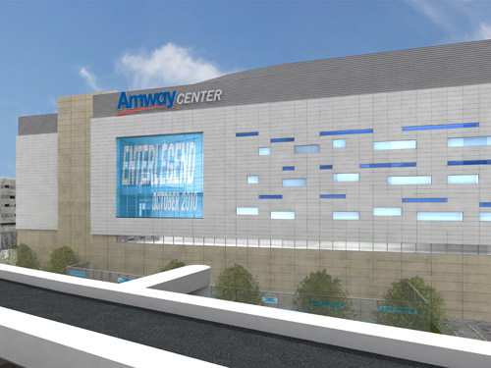
Introduction
The new Amway Center is a “State of the Art” Green facility.
The new center opened its doors on October 1, 2010 replacing the old Amway Arena.

Slide 4
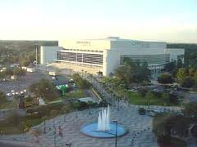
History
The history of the arena dates back to 1983.
The City of Orlando was seeking a downtown arena to hold concerts and large scale events.
Construction was completed in 1989 at a cost of $110 million dollars.

Slide 5
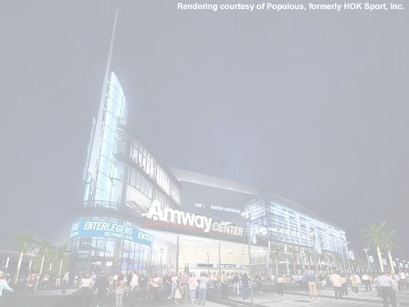
The City of Orlando and Orange County agreed on building a new arena along with contributions from the Orlando Magic.
A new arena would help the City of Orlando and the declining Parramore neighborhood.
The mayor of Orlando wanted to revitalize this historical district.

Slide 6
Amway Center SWOT Analysis
Benefits Outweigh Burdens
Strengths Design | Focus
Weaknesses Location | Debt
Opportunities Capacity | Services
Threats Fluctuations | competition

Slide 7
Strengths Weaknesses Opportunities Threats
Strengths
Environmentally friendly design | Multipurpose
LEED Silver certified | Community focused
High tech
Weaknesses
Unreliably supported | Debt ridden
Compromised by location | Struggling to compete
Very easily congested
Opportunities
Outreach focused | Capital growth capable
Large capacity capable | Consumer attractive
Robust in products and services development
Threats
Sensitive to team availability | Susceptible to vendor competition
Vulnerable to economy fluctuations | Challenged by scalpers
Dependent on weather patterns

Slide 8
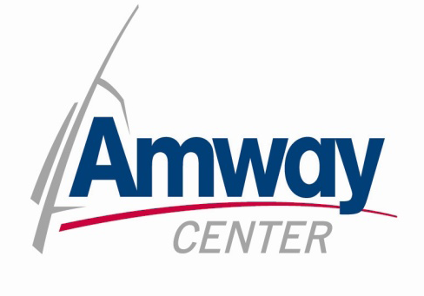


The Amway Center is a premier sports , events and entertainment venue in Orlando, Florida and the home of the Orlando Magic of the NBA and the Orlando Predators of the AFL.
2 NBA large locker rooms; 6 star performer dressing rooms; green rooms for staging and hospitality; additional auxiliary locker rooms, including an official’s locker room.
Full basketball practice court that can also be used for events seating up to 500 people.
Media interview room and working media facilities on Event Level.
Large LED video board on I-4 exterior façade for event advertising.
31,000 sf arena floor for exhibition/trade show space, banquets and meetings.
5 banquet rooms and a conference room on the Club Level.
6 loading docks.
The Amway Center is dedicated to bringing the best entertainment (sporting, events, and concerts) to the Orlando Area. They now provide the “Ultimate Venue for Every Performer” and boast :

Slide 9
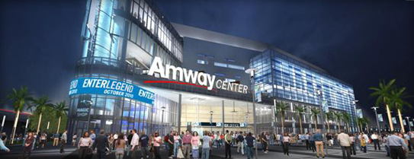
This is unlike ANYTHING Orlando has ever seen! Come see for yourself!

Slide 10
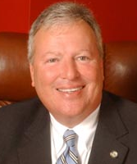
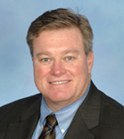
The Amway Center was designed to reflect the character of the community, meet the goals of the users and build on the legacy of sports and entertainment in Orlando. So what are people saying?
"I'm very excited,” Irvin said. “I've been checking out the progress all year and can't wait to get inside.“
Ed Irvin
Orlando Mayor Buddy Dwyer, “This community venue was built by and is dedicated to the residents of Central Florida. Previously, our region lacked the modern facilities needed to attract top notch entertainment and sporting events, forcing residents to travel elsewhere to experience them. Orlando is now home to one of the most technologically-advanced areas in the country providing a vast array of cultural, sporting and entertainment options to residents.”
"This lobby is just huge to walk in,” said Todd Ludington from Orlando. “It's just open and lots of light and lots of windows. It’s incredible."
Allen Johnson, the Executive Director of Orlando Venues which manages the Amway Center, “Orlando Venues exists to provide the citizens of Central Florida with a diverse collection of sports, arts and culture designed to excite, inspire and create the ultimate entertainment experience.”
“It is gorgeous, and guess what? Plenty of bathrooms," said Joanna Wallace.

Slide 11
Future Amway Center Events/Plans
Two NBA locker rooms; large home and visiting arena football/hockey locker rooms; six star performer dressing rooms; green rooms for staging and hospitality; additional auxiliary locker rooms, including an official’s locker room.
Full basketball practice court that can also be sued for events seating up to 500 people.
Media interview room and working media facilities on Event Level.
Large LED video board on I-4 exterior façade for event advertising.
31,000 sq ft arena floor can be used for exhibition/trade show space, banquets and meetings.
Five banquet rooms and a conference room on the Club Level.
Six loading docks.

Slide 12
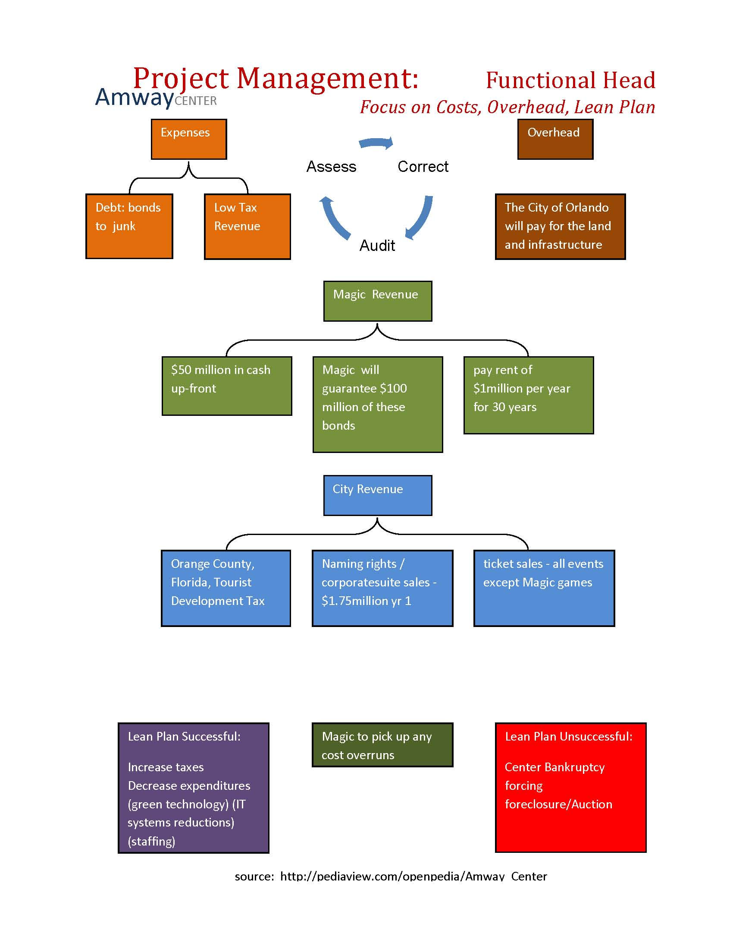
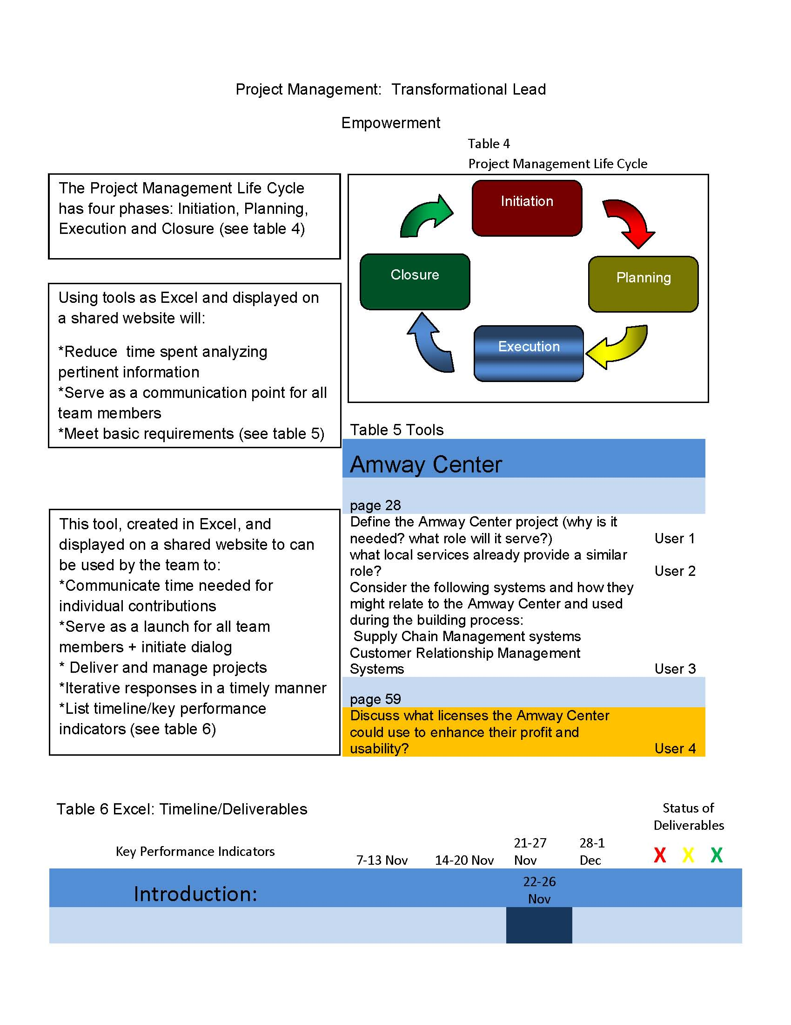

Slide 13
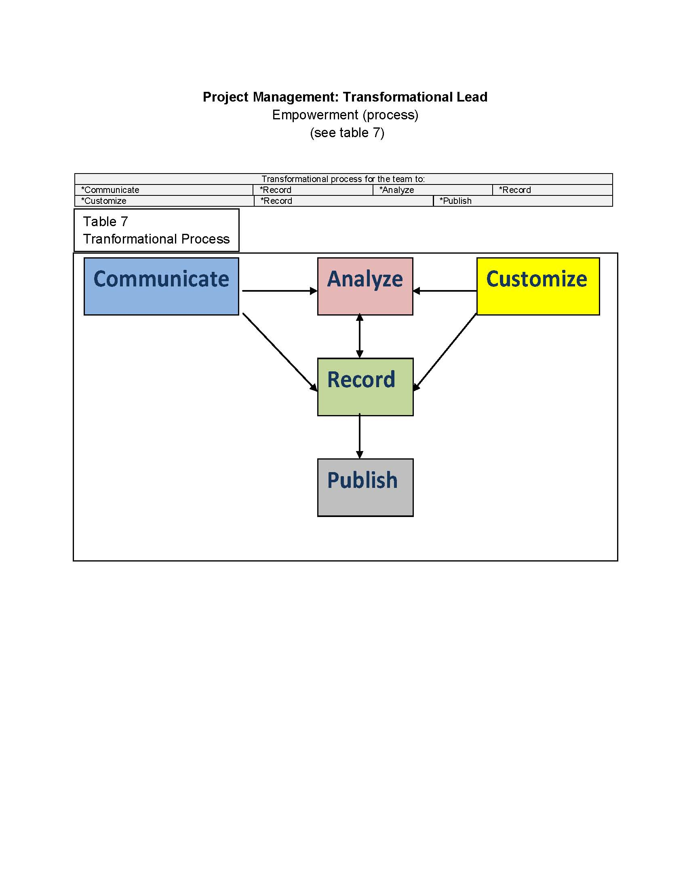
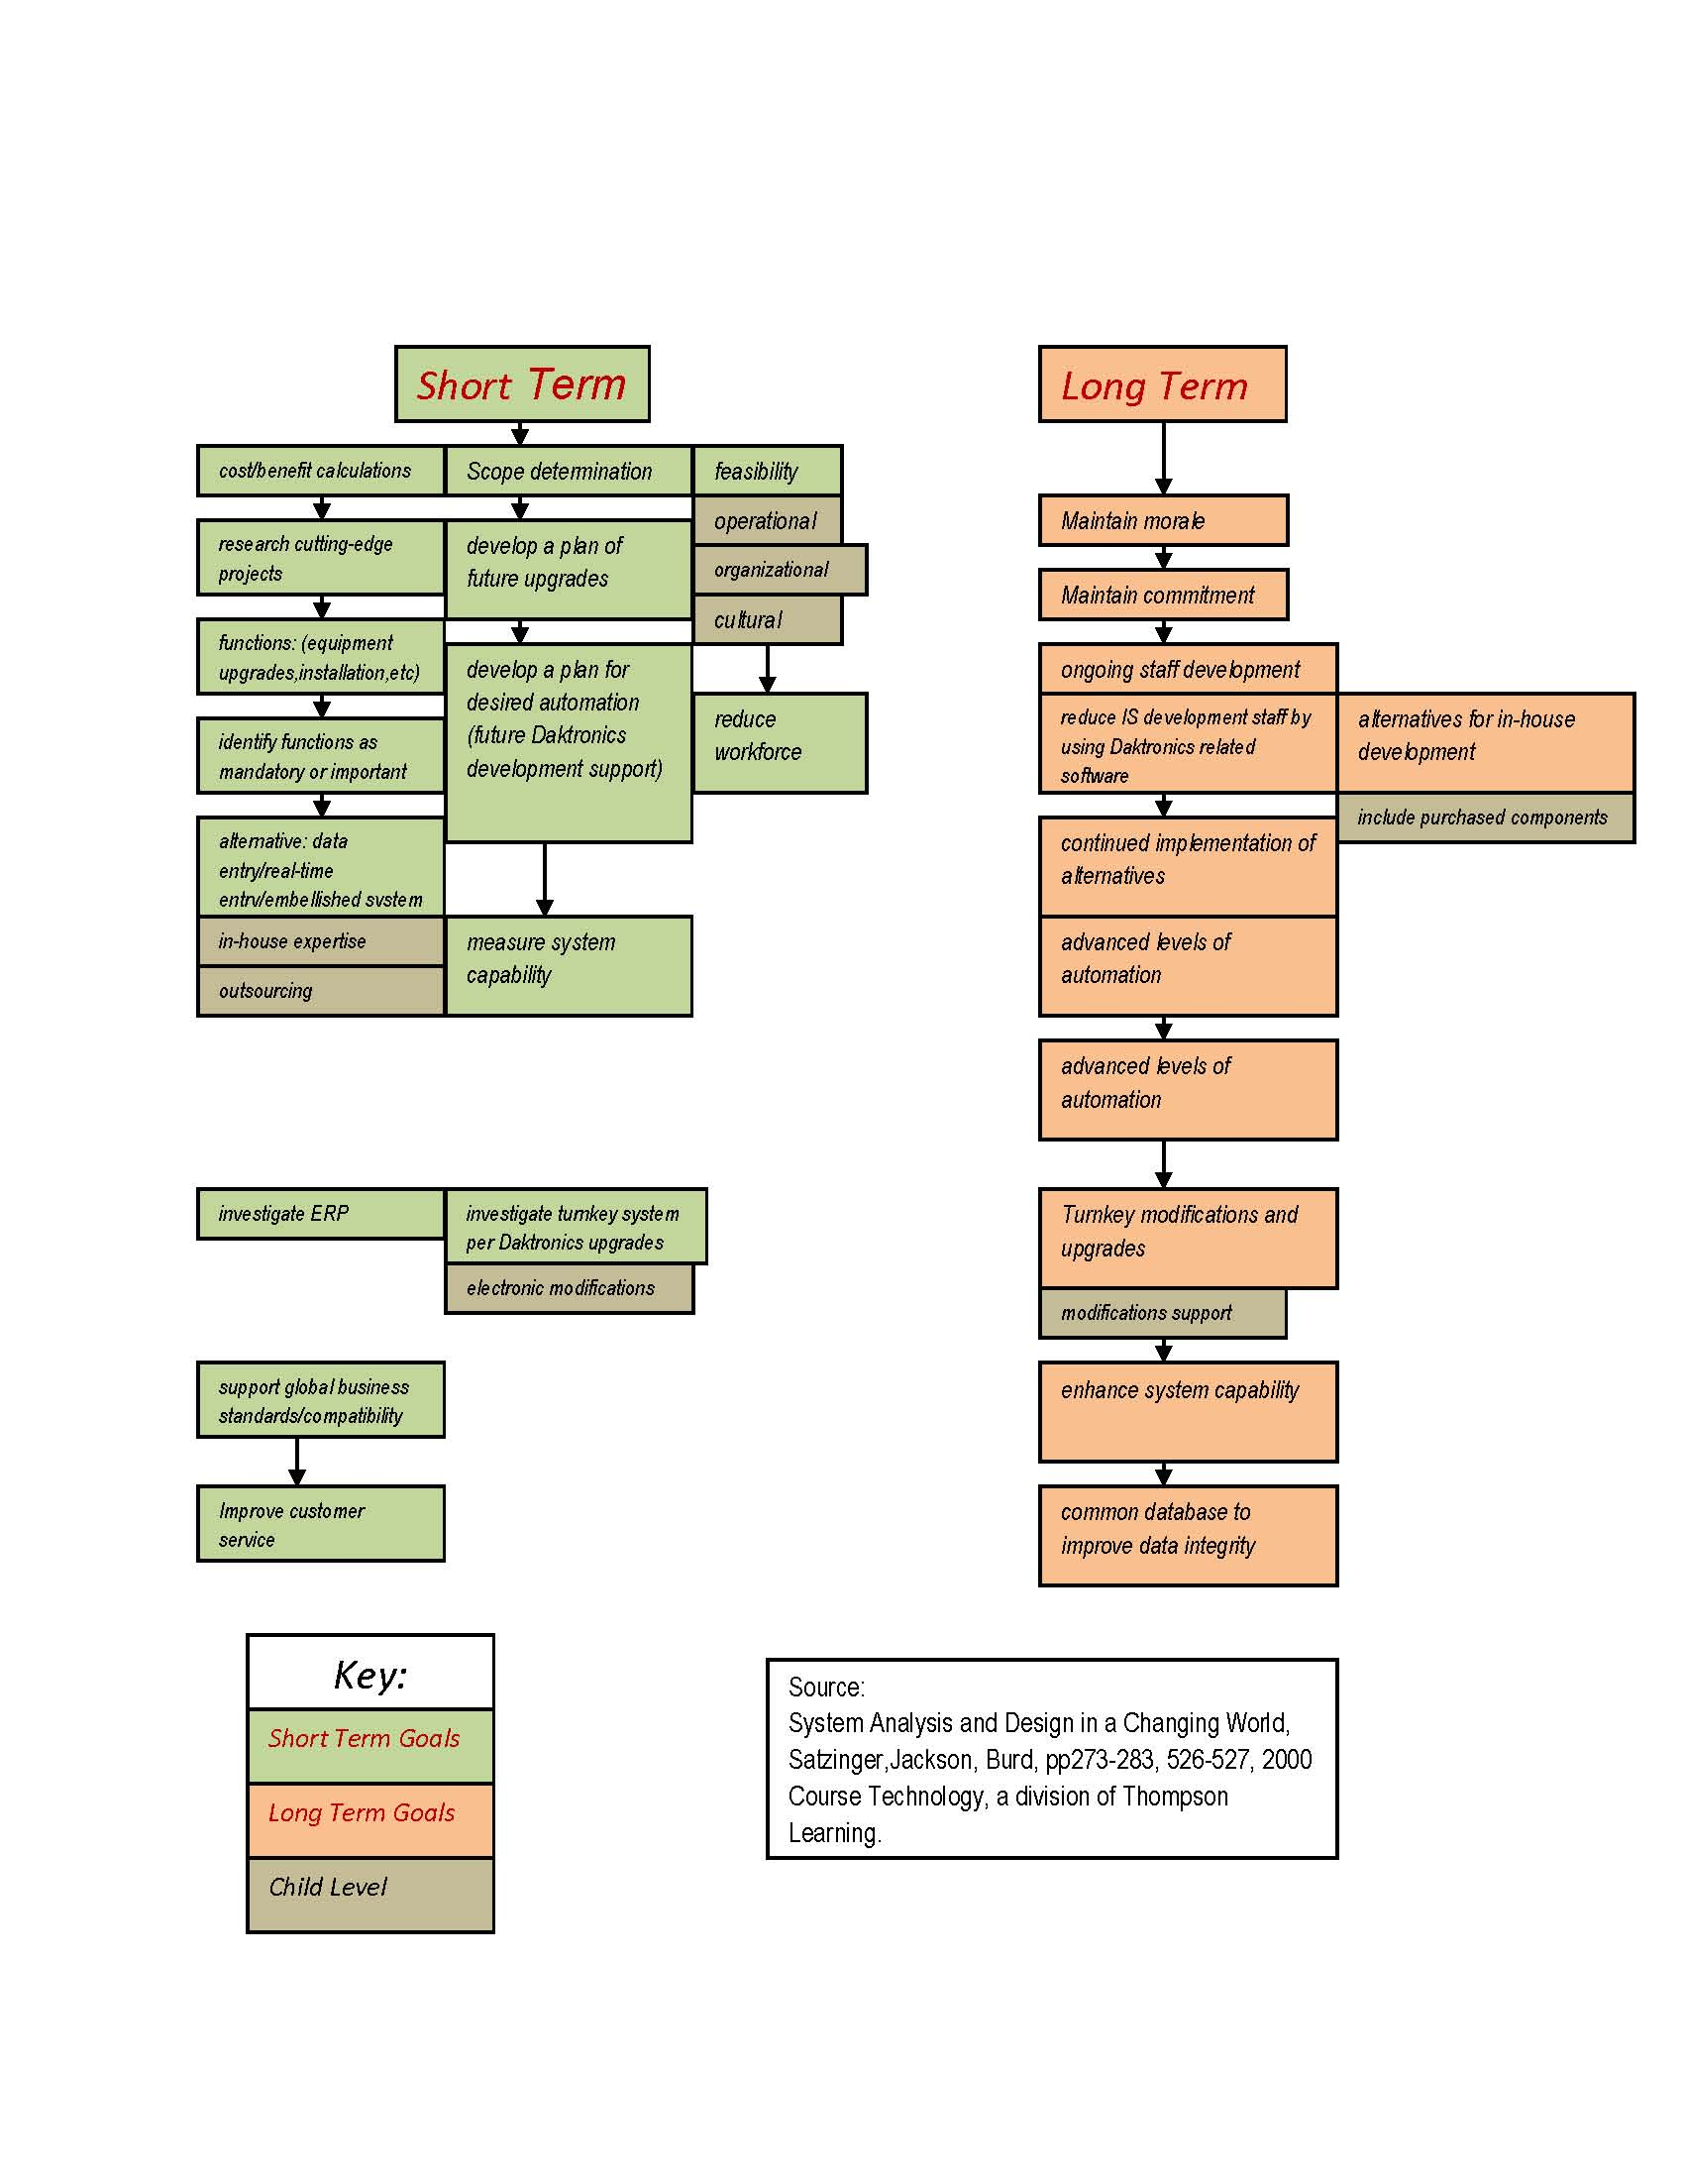
Project Management: Business Strategist Amway Center Short & Long Term Bottom Line Goals
Daktronics, Inc. will WOW the world with its integrated super system both inside and outside the Amway Center to bring the audience a full digital experience. Will it be prudent to put ALL of the eggs in the Daktronics’ basket, or should the Amway Center have its own key support? Short and long range bottom line goals point to the success of this super system as it grows and improves into the future (see Table 7a). As the Amway Center begins to answer the community’s questions for appropriate venues, the super system will modify and improve to meet those needs. Staying on top of the entire system, the Amway Center can hold close the control and supervision that is needed to best benefit the Orlando and surrounding communities. Turnkey systems have their benefits, but as this center becomes integrated into the central Florida community, procedures will need to be in place for optimum success for a robust system that will continue to support the specific IT requirements to maintain and upgrade what is taking place on the “ground level”. As the venues’ systems become more complicated and demanding, the Amway Center’s IT department will step up to the plate to support and implement a successful system to pull off the shows for excited audiences.

Slide 14
SMARTER Measured
Steps
Measurable
Achievable
Realistic
Time
Ethical
Recorded
Approval
Asset to environment
Approval
Project mission
Approval
Systems: Experienced reputation
Installations
Ground breaking
Employment boost
Construction initiation
Communications
1 yr: Ground breaking
Proven deliverables
Networking
Construction
New shopping
Naming
Definitions
1 yr: naming
Guarantee
Compatibility
Systems installation
Grand opening
Leadership
1 yr: opening
Best practices
Interior|exterior displays
Opening
Railroad connection
Best practices
Leadership
Community improvements
Skills training
Old arena demolition
Skills retraining

Slide 15
GUANXI The Deal – Who Pays for What and How?
Kaizen
How It Affects the Citizens and
the Area
Total cost of the new Amway Center is $480 million.
Orlando Magic contributed at least $50 million in cash up-front, picked up any cost overruns, and will pay rent of $1 million per year for 30 years
The City of Orlando paid for the land and infrastructure and with the remaining money coming from bonds which would be paid off by part of the Orange County Tourist Development Tax.
Orlando Magic and City of Orlando worked closely with local minority and women-owned businesses and awarded them with more than 30% of the contracts totaling $90-plus million.
The demand for parking has intensified. While the arena has 18,500 seats, the new garage built next to it has 1,285 parking spaces and 600 of those are reserved for the Magic and premium-ticket holders.
Some innovative residents in the Amway Center neighborhoods are providing by offering parking in their yards and driveways for a fee.
The restaurants in the area are experiencing an influx of patrons.
Hotels in the area are also experiencing a higher occupancy since the Amway Center opened.
The Amway Center is also helping the community by assisting in charitable work.
The graduations of many local high schools will now take place in the new Amway Center and with new 42-foot by 41-foot jumbotron, no one will feel too far away anymore.
Risk Adversity
2 Main Risks
The bonds used to finance the arena have been downgraded to “junk” status. With this downgrade, the possibility of losing the center to bankruptcy is high and very possible in just a few years.
In order to sustain the economic boon to the area and to be able to maintain the new Amway Center, they have to be able to book high profile events and performances that will draw large numbers of consumers.

Slide 16
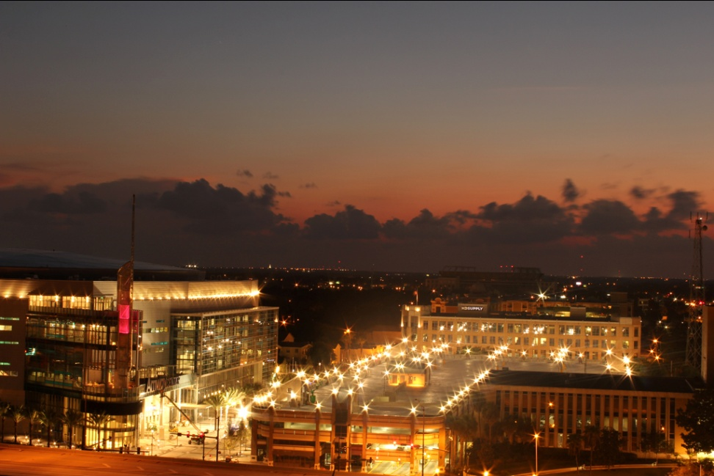
Conclusion
The Amway Center was designed to reflect the character of the community, meet the goals of users and creates high definition super systems.

Slide 17
Works Cited
Amway Center, "Amway Center Home Page." 4 Dec 2010. Amway Center. <http://www.amwaycenter.com/> |  | Munsey & Suppes."Amway Arena."2010. Ballparks.com. <http://basketball.ballparks.com/NBA/OrlandoMagic/index.htm>
Amway Center, "Concerts and Events." 4 Dec 2010. Amway Center. <http://amwaycenter.com/concerts-and-events> |  | Satzinger, John W., Jackson, Robert B., Burd Stephen D., System Analysis and Design in a Changing World.Cambridge: 2000 Course Technology Thompson Learning, 2000.
Amway Center, "About the City of Orlando." 4 Dec 2010. Amway Center. <http://amwaycenter.com/about-city-orlando> |  | Steinkamp, Mark,"Orlando’s New Amway Center to Feature Daktronics Integrated Super System" 11 Nov 2009. Daktronics.com http://www.daktronics.com/Company/NewsReleases/Pages/OrlandoMagic.aspx
Amway Center, "Promoter Guide." 4 Dec 2010. Amway Center. <http://amwaycenter.com/promoter-guide> |  | Amway Center, “Press Release” 4 Oct 2010. Amway Center <http://amwaycenter.com/press-room/press-releases
Amway Center, "Press Room" 4 Dec 2010. Amway Center. <http://amwaycenter.com/press-room> |  | Orlando Sentinel “Orlando Magic Reach Fair deal on arena details” 23, Dec 2006. Orlando Sentinel <http://articles.orlandosentinel.com/2006-12-23/news/ARENA23_1_orlando-magic-deal-city-commissioners
Amway Center, "Venue" 4 Dec 2010. Amway Center. <http://www.amwaycenter.com/venue> |  | Orlando Sentinel “Orlando risk default on Magic arena bonds, Analyst warn” 3, Apr 2010 Orlando Sentinel <http://articles.orlandosentinel.com/2010-04-03/news/os-magic-arena-junk-bonds-20100403_1_arena-bonds-default-fitch-ratings
Barrett, Alex, "Amway Center a Magical New Home for the NBA and Orlando." 2010 CBSSports.com <http://bleacherreport.com/articles/479529-amway-center-a-magical-new-home-for-the-nba-and-orlando> |  | Orlando Sentinel “Orlando’s newest landmark” 14, Nov 2010. Orlando Sentinel <http://www.orlandosentinel.com/sports/highschool/varsitylife/os-amway-varsity-life-111410-20101114,0,4884856.story
City of Orlando. "History of Pathways for Parramore." 2010. City of Orlando. 1 Dec 2010 http://www.cityoforlando.net/elected/parramore/history.htm |  | Orlando Sentinel “Cha-Ching! Florida Classic is a Multimillion-Dollar Boost to region.”19, Nov 2010 Orlando Sentinel <http://www.orlandosentinel.com/news/local/os-florida-classic-advance-20101119,0,5121074.story
Dyer, Buddy. "State of Downtown Address." 1 Oct 2010. City of Orlando. <http://www.cfnews13.com/static/articles/images/documents/State-of-Downtown. 2010.pdf> |  | Orlando Sentinel “Circus food drive collects nearly 1.5 tons of food” 18, Nov 2010 Orlando Sentinel <http://blogs.orlandosentinel.com/entertainment_stage_theat/?p=10408
FloridaBrazil.com, "Orlando Florida City Guide." 2010. FloridaBrazil.com. <http://www.floridabrasil.com/orlando-florida-vacation-travel-guide.html>

